Slide 1
HOUSING
HOMELESS IN AMERICA

Slide 2

SHELTER. SAFETY. STABILITY.
HOMELESS IN AMERICA
ON ANY GIVEN NIGHT HALF A MILLION PEOPLE ARE HOMELESS.
MOST AMERICANS REPORT THAT THEY LIVE PAY CHECK TO PAY CHECK WITH OVER HALF OF THE WORKFORCE ONLY EARNING MINIMUM WAGES.
PRINCETON EVICTION LAB
A BETTER TOMORROW
Homelessness in America is a deepening crisis that is inextricably linked to poverty and systemic injustice. The lack of affordable housing sits at the root of a host of social problems, from mental health care and low wages to educational and racial disparities. In this project, I gathered publicly available data to build a predictive model that provides insight into the homelessness population growth.
LEARN MORE

Slide 3
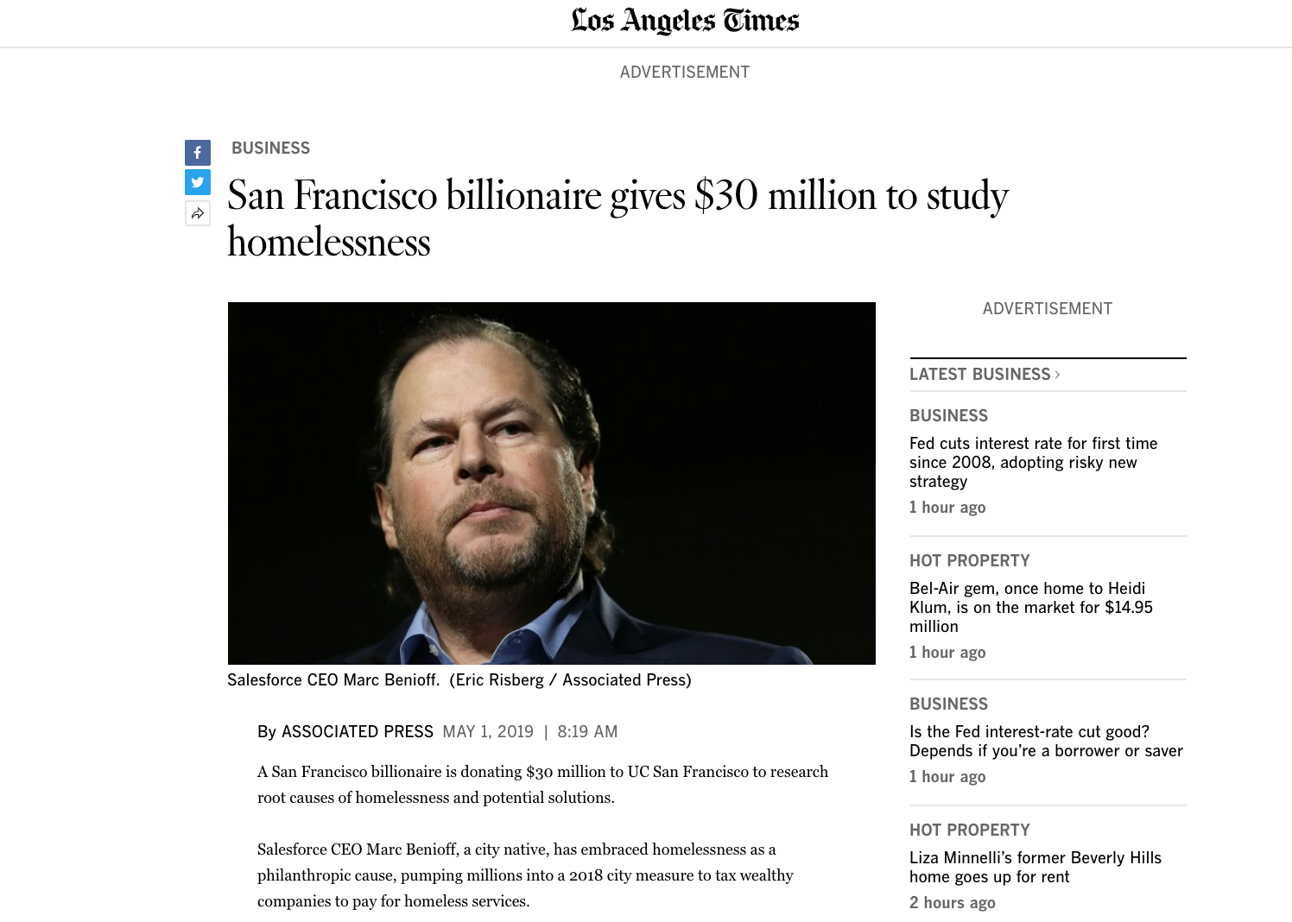
THE INSPIRATION
“Benioff approached the university because he wanted officials spending tax money to make decisions with the best data available, Kushel said. The plan is for researchers to study the data and provide neutral, trusted analysis.”

Slide 4
DETERMINING THE INPUTS
WHAT CAUSES HOMELESSNESS
THE RISK FACTORS ASSOCIATED WITH HOMELESSNESS
LACK OF AFFORDABLE HOUSING
DOMESTIC VIOLENCE
ADDICTION
The nation is currently facing one of the most severe affordable housing crises in history. Today, 7.8 million extremely low-income households pay at least half of their income toward housing, putting them at risk of housing instability and homelessness.
A domestic violence experience is common among youth, single adults, and families who become homeless. For many, it is the immediate cause of their homelessness.
The issue of opioid abuse has risen to a level of national crisis as the number of people abusing prescription drugs and heroin has dramatically risen, and the rate of opioid-related overdose deaths has tripled since 2000.
LOW INCOME
RACISM AND HOMOPHOBIA
In May 2019, there were 61,129 homeless people, sleeping each night in the New York City municipal shelter system. Families make up nearly three-quarters of the homeless shelter population. Homelessness has reached the highest levels since the Great Depression of the 1930s
The typical American worker has seen little to no growth in his/her weekly wages over the past three decades. Too little income combined with the dwindling availability of low-cost housing leaves many people at risk for becoming homeless.
By far the most striking disproportionality can be found among African Americans, who make up 40 percent of the homeless population despite only representing 13 percent of the general population. This imbalance is not improving over time.
PHYSICAL AND MENTAL HEALTH
EVICTIONS
DIVORCE OR BEREAVEMENT
On a given night in 2017, 20 percent of the homeless population reported having a serious mental illness and more than 10,000 people had HIV/AIDS.
Most evictions happen because renters cannot or do not pay their rent. Landlords can evict renters for a number of other reasons, too, including taking on boarders, damaging property, causing a disturbance, or breaking the law.
A divorce, death, or the break up of family is a known factor. The financial shock of dovorce, a sudden need to move, and lack of a support network increase the risk.

Slide 5

USING PUBLICLY AVAILABLE DATA, CAN WE PREDICT THE NUMBER OF HOMELESS PEOPLE IN A GIVEN COMMUNITY?

Slide 6
DATA SOURCES
ALL DATA POINTS CAME FROM PUBLICLY AVAILABLE GOVERNMENT AND UNIVERSITY SOURCES FOR THE YEARS 2007 -2016
PRINCETON EVICTION LAB DATA
SOCIAL SECURITY ADMINISTRATION
REPORTS
DEPARTMENT OF HOUSING AND URBAN DEVELOPMENT
DATA
STATE MENTAL HEALTH AGENCY REPORTS
DEPARTMENT OF LABOR DATA

Slide 7
DATA MANIPULATION AND CLEANING
PROJECT CHALLENGES
CONTINUUM OF
CARE
EACH STATE IS DIFFERENT

Slide 8
PLACE VISUALIZATION HERE

Slide 9
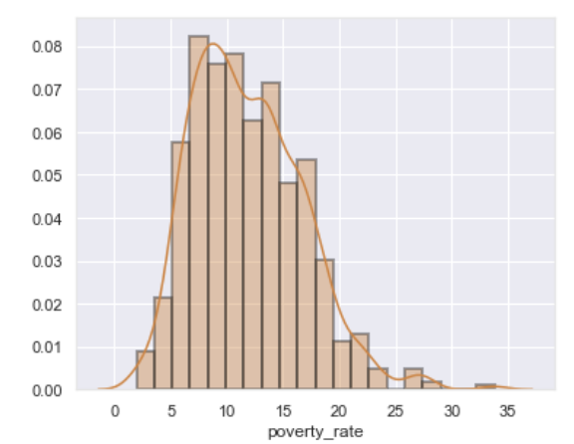
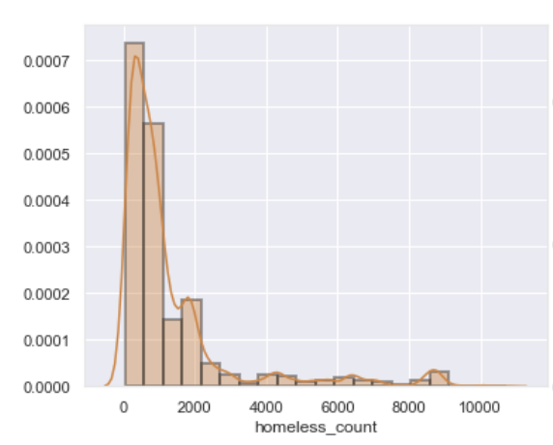
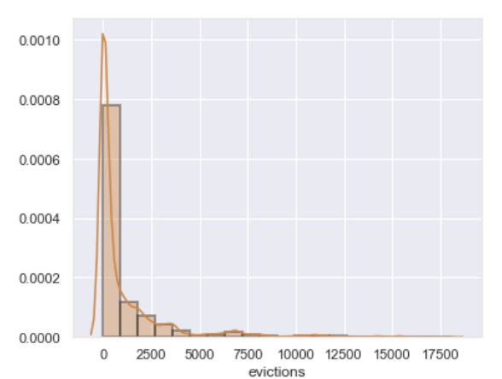
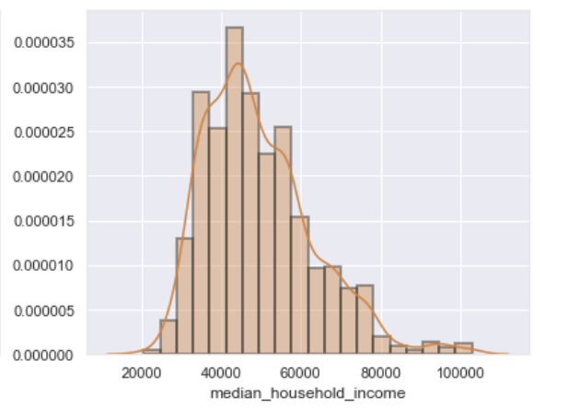
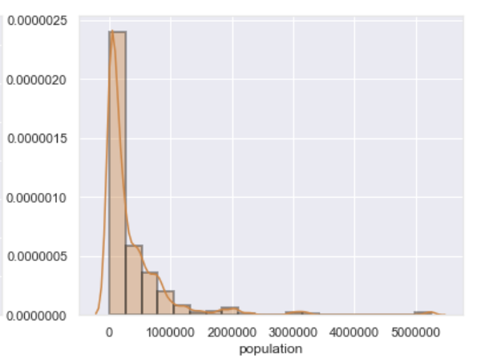
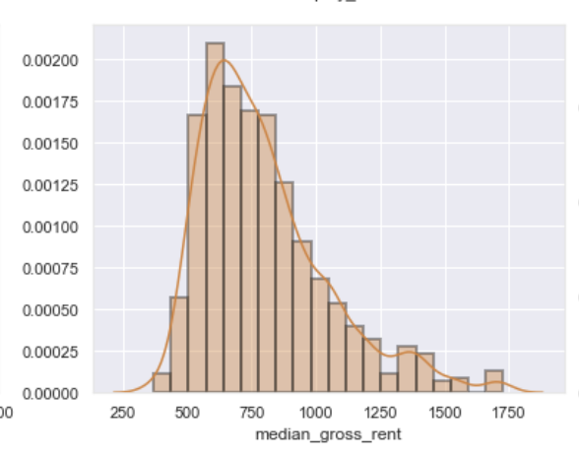
CONTINUUM OF CARE.
HOMELESS COUNTS.
EVICTION RATES.
POPULATION SIZE.
RACIAL DEMOGRAPHICS.
RENTING HOUSEHOLDS.
SOCIAL SECURITY BENEFITS.
UNEMPLOYMENT RATE.
MENTAL HEALTH FUNDING.
POVERTY RATE.
MEDIAN INCOME.
EVICTION FILING RATE.
MEDIAN RENTAL RATE.
POPULATION SIZE.
DATA SCIENCE PROCESS
EXPLORATORY DATA ANALYSIS

Slide 10
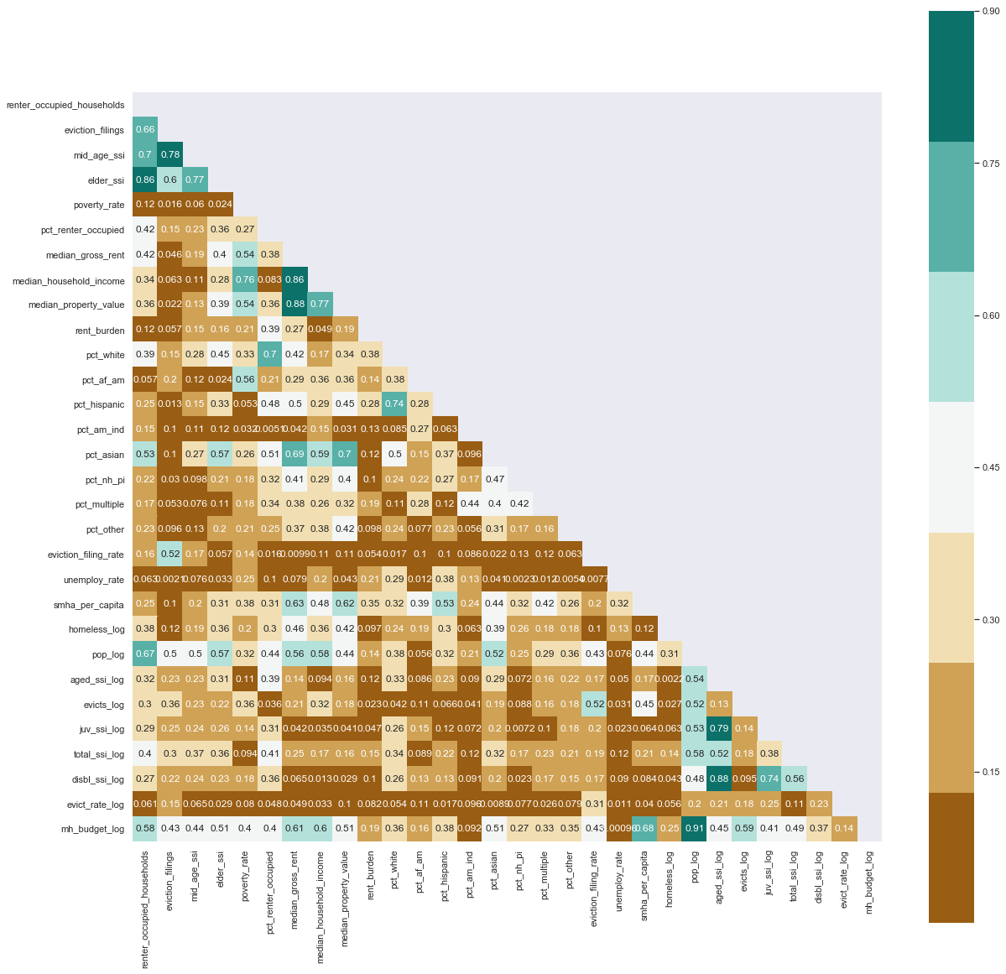
FEATURE ENGINEERING & SELECTION
BY CREATING NEW FEATURES FROM EXISTING DATA, I WAS ABLE TO GET BETTER PREDICTIONS.
DOMAIN KNOWLEDGE FEATURE
INTERACTION FEATURES
CORRELATION < .90
L1 REGULARIZATION

Slide 11
MODEL SELECTION
LINEAR REGRESSION
DECISION TREE REGRESSION
RANDOM FOREST
REGRESSOR
XGBOOST
REGRESSOR
R2: 0.63
MSE: 0.42
R2: 0.80
MSE: 0.22
R2: 0.93
MSE: 0.08
R2: 0.74
MSE: 0.29

Slide 12
TOP 10 MOST IMPORTANT MODEL FEATURES
USING RANDOM FOREST REGRESSION
PARAMETERS MAX DEPTH 18, N ESTIMATORS 1000:
EVICTION RATE
⚬
PERCENTAGE OF HISPANIC RESIDENTS
MENTAL HEALTH SPEND PER CAPITA
⚬
PERCENTAGE OF AFRICAN AMERICAN RESIDENTS
PERCENT RENTER OCCUPIED HOUSEHOLDS
⚬
PERCENT WHITE RESIDENTS
ELDERLY SOCIAL SECURITY TOTAL
POPULATION
⚬
MEDIAN PROPERTY VALUE
PERCENT RENTER OCCUPIED
PERCENT WHITE RESIDENTS
⚬
MENTAL HEALTH SPEND PER CAPITA
POPULATION TOTAL
PERCENTAGE OF NATIVE HAWAIIAN AND PACIFIC ISLANDER
TOTAL MENTAL HEALTH BUDGET

Slide 13
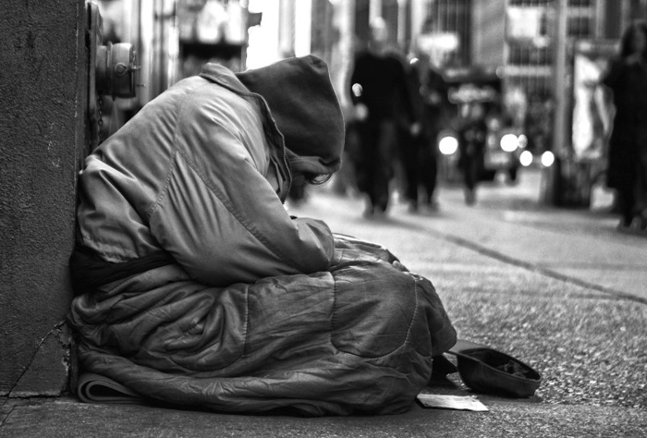
RESULTS AND NEXT STEPS
INCOME, RENTERS, POVERTY RATE, MENTAL HEALTH CARE FUNDING,
RACIAL DIVERSITY, PUBLIC BENEFITS, ELDERLY POPULATIONS, AND EVICTIONS CAN HELP US PREDICT THE POTENTIAL RISK OF HOMELESSNESS.
NEXT STEPS ARE TO COLLECT 2017- 2019 DATA & DIVORCE, DOMESTIC VIOLENCE, ADDICTION, AND TRAUMA DATA IN THE AREAS WHERE THE UNITED STATES MEASURES HOMELESSNESS.

Slide 14
FINAL PROJECT FOR FLATIRON SCHOOL DATA SCIENCE PROGRAM
JENNIFER MCKAIG
Data Scientist, Diversity and Inclusion HR Leader, and Social Worker
https://www.linkedin.com/in/jenmckaig/
jenmckaig@gmail.com
GITHUB @JENMCKAIG
MORE

